Slide 1
Physical Computing

Slide 2
Breadboard

Slide 3
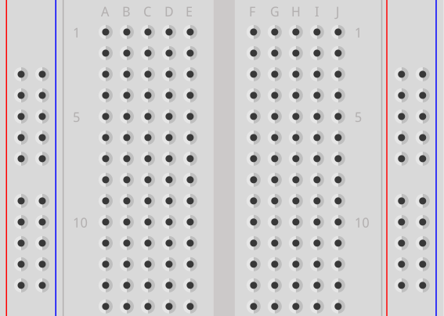
Breadboard
Power rails
Power rails
Terminal strips
Power rails:
Vertical ↕
Terminal strips:
Horizontal ↔

